Slide 1
Anomaly Detection in Molecular Communications With Applications to Health Monitoring Networks
Group Members:
Kesha Bagadia (AU1841011)
Manal Shah (AU1841026)
Yashvi Gandhi (AU1841033)
Yashvi Pipaliya (AU1841092)

Slide 2
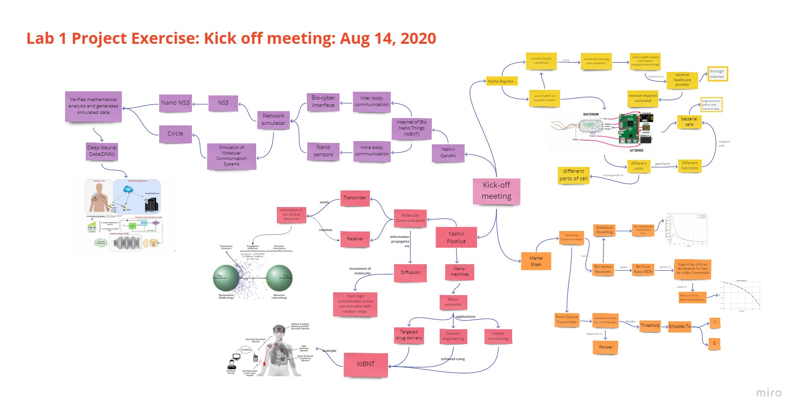
Project Kick off meeting

Slide 3
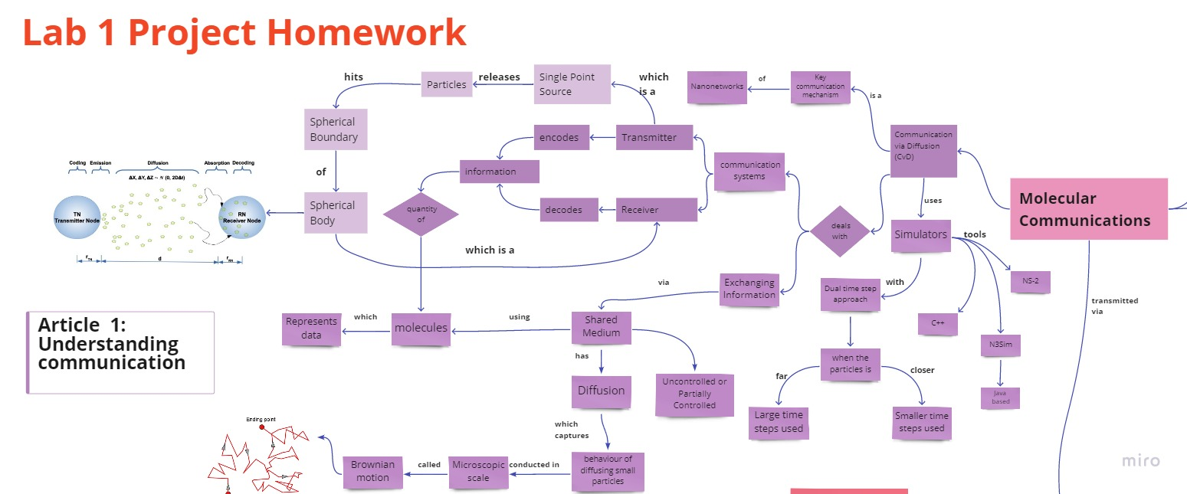
Selection Process for Base Article

Slide 4
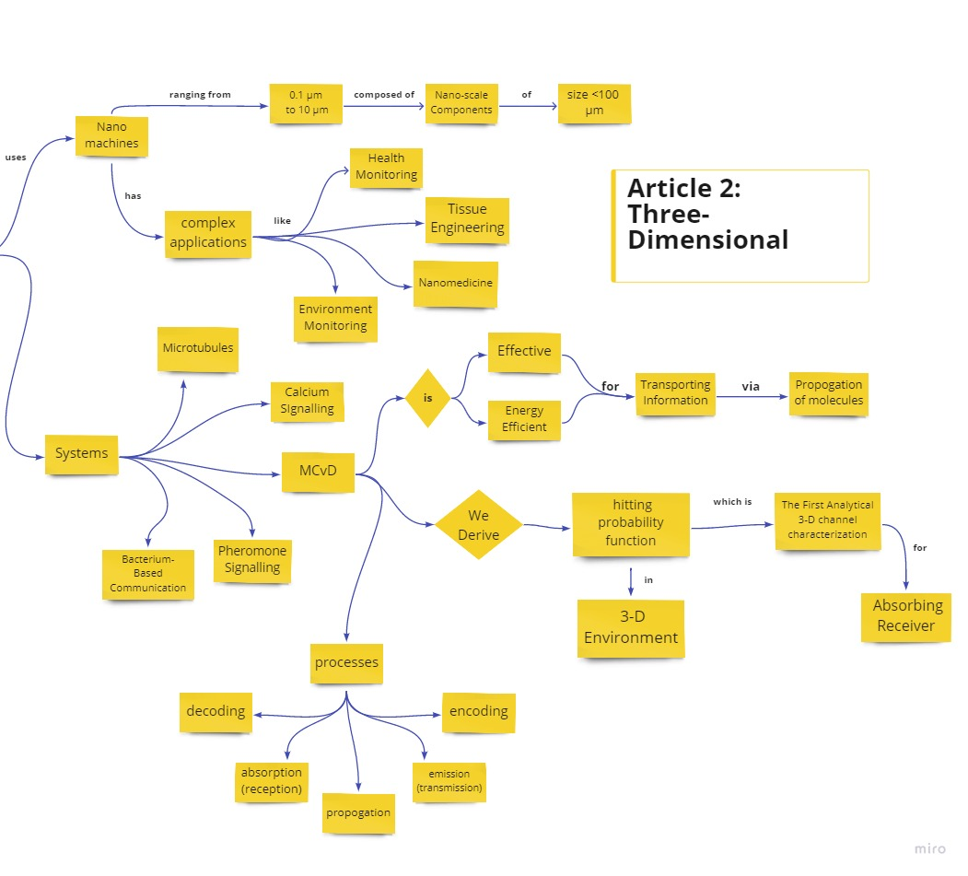

Slide 5
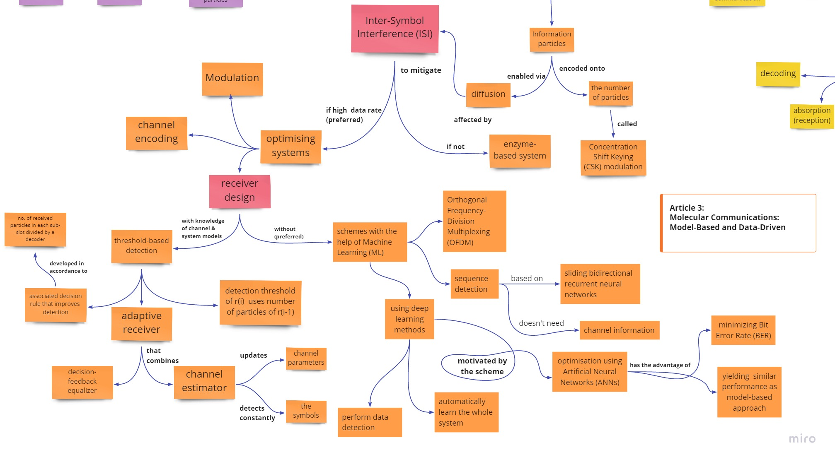

Slide 6
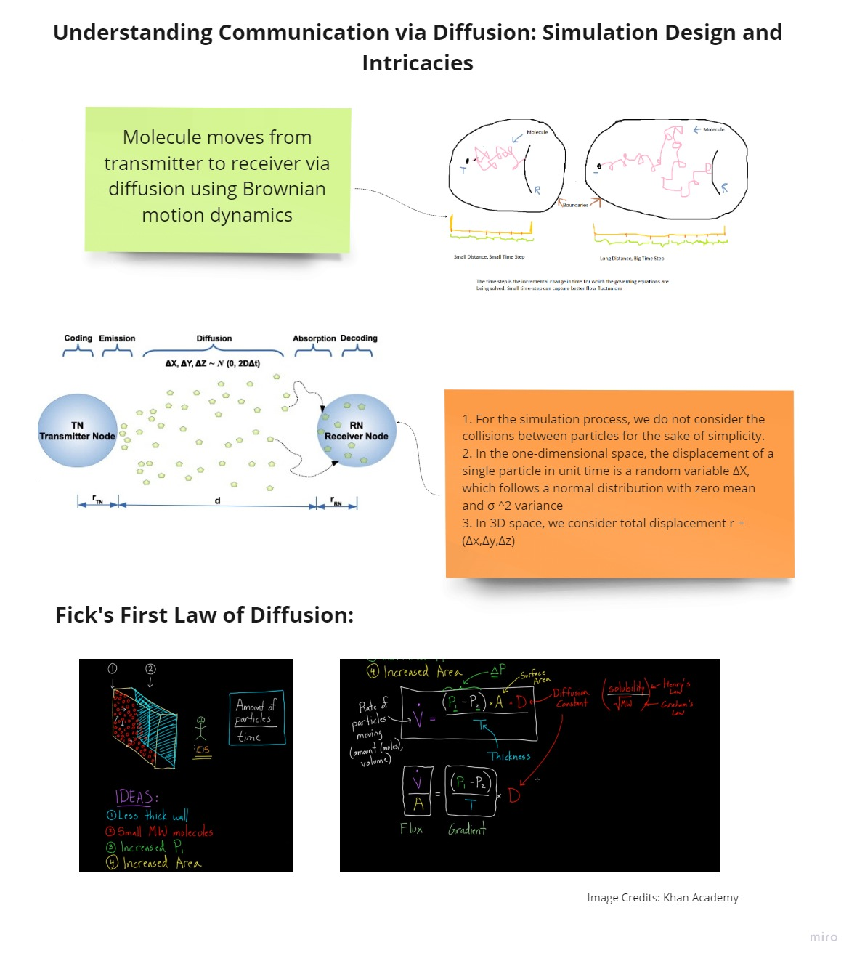
Analysis of
Base article
Part 1

Slide 7
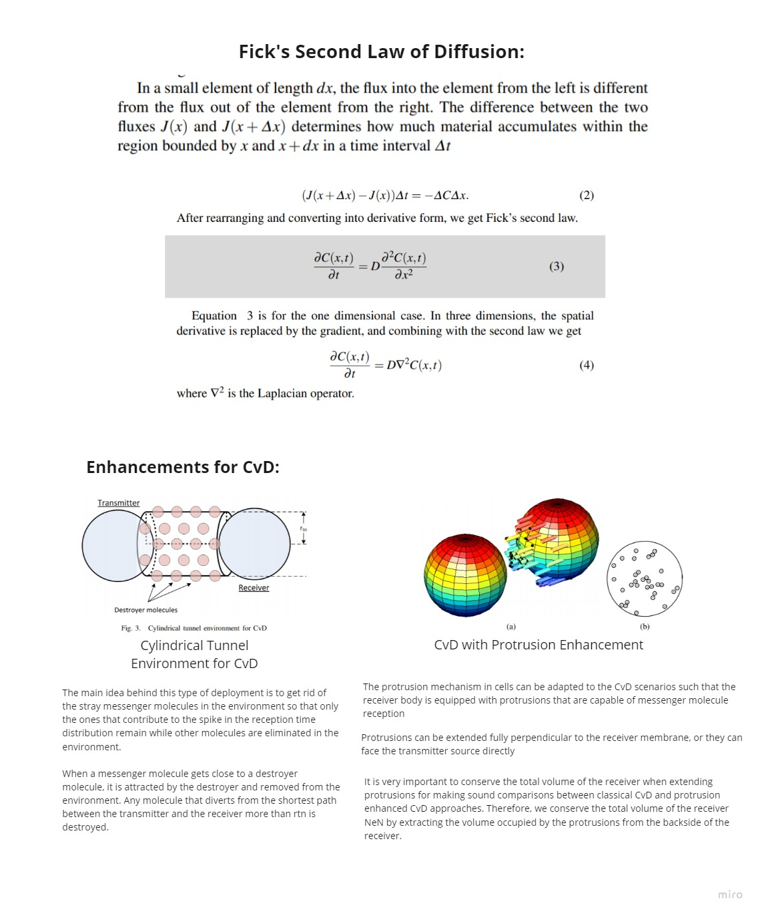
Analysis of
Base article
Part 2

Slide 8
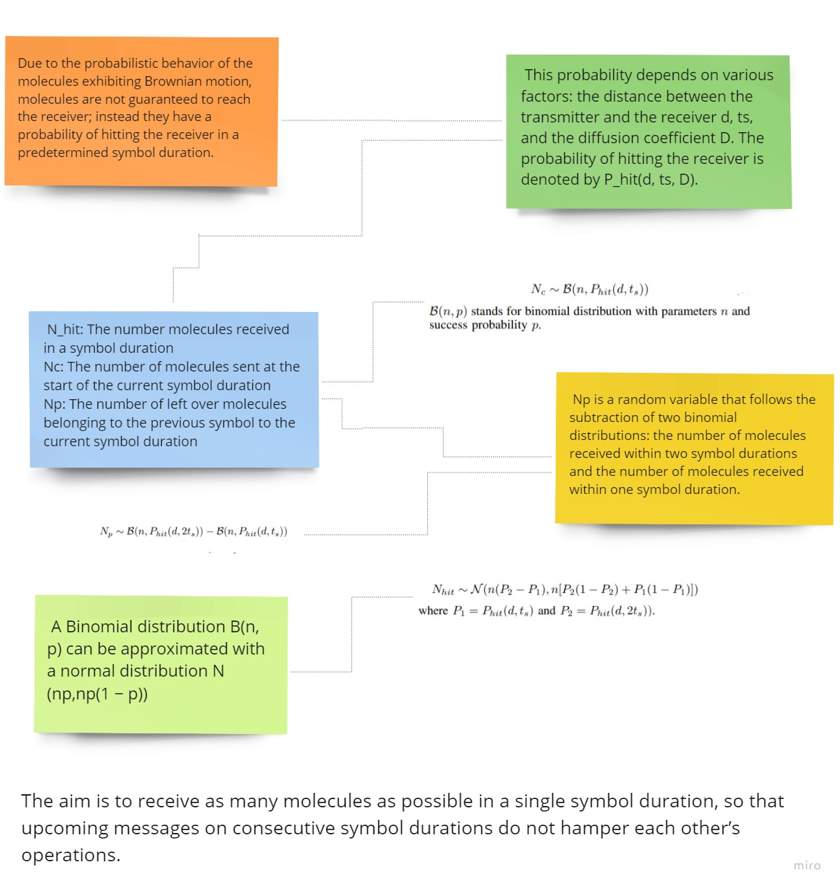
Analysis of
Base article
Part 3

Slide 9
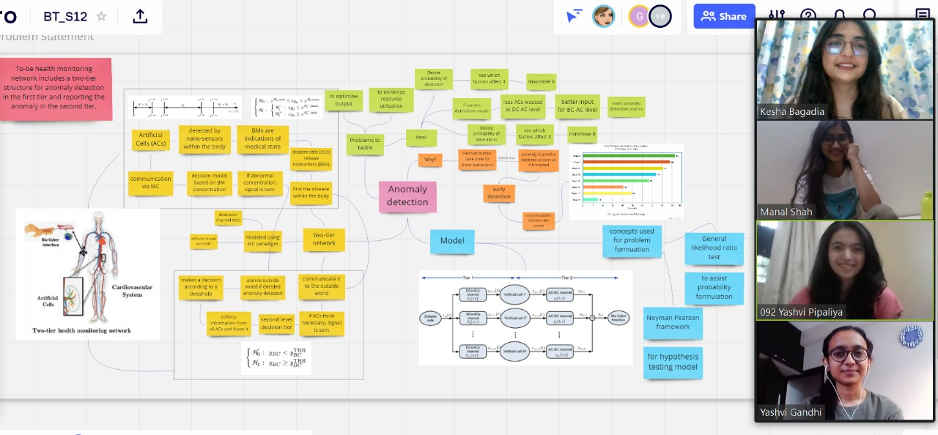
Problem Statement

Slide 10
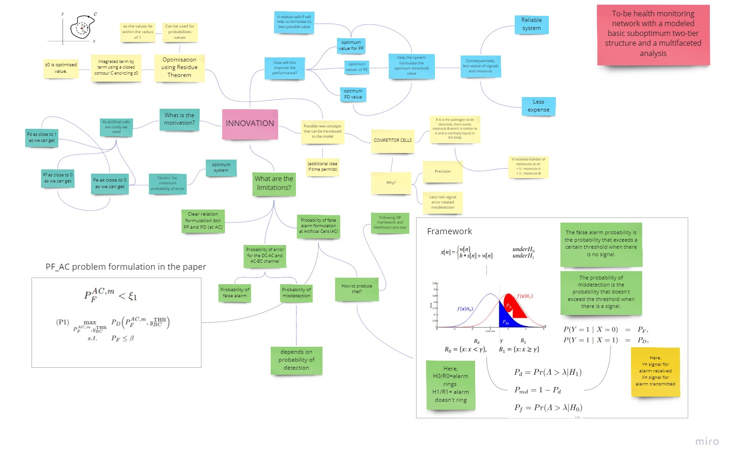
Innovation

Slide 11
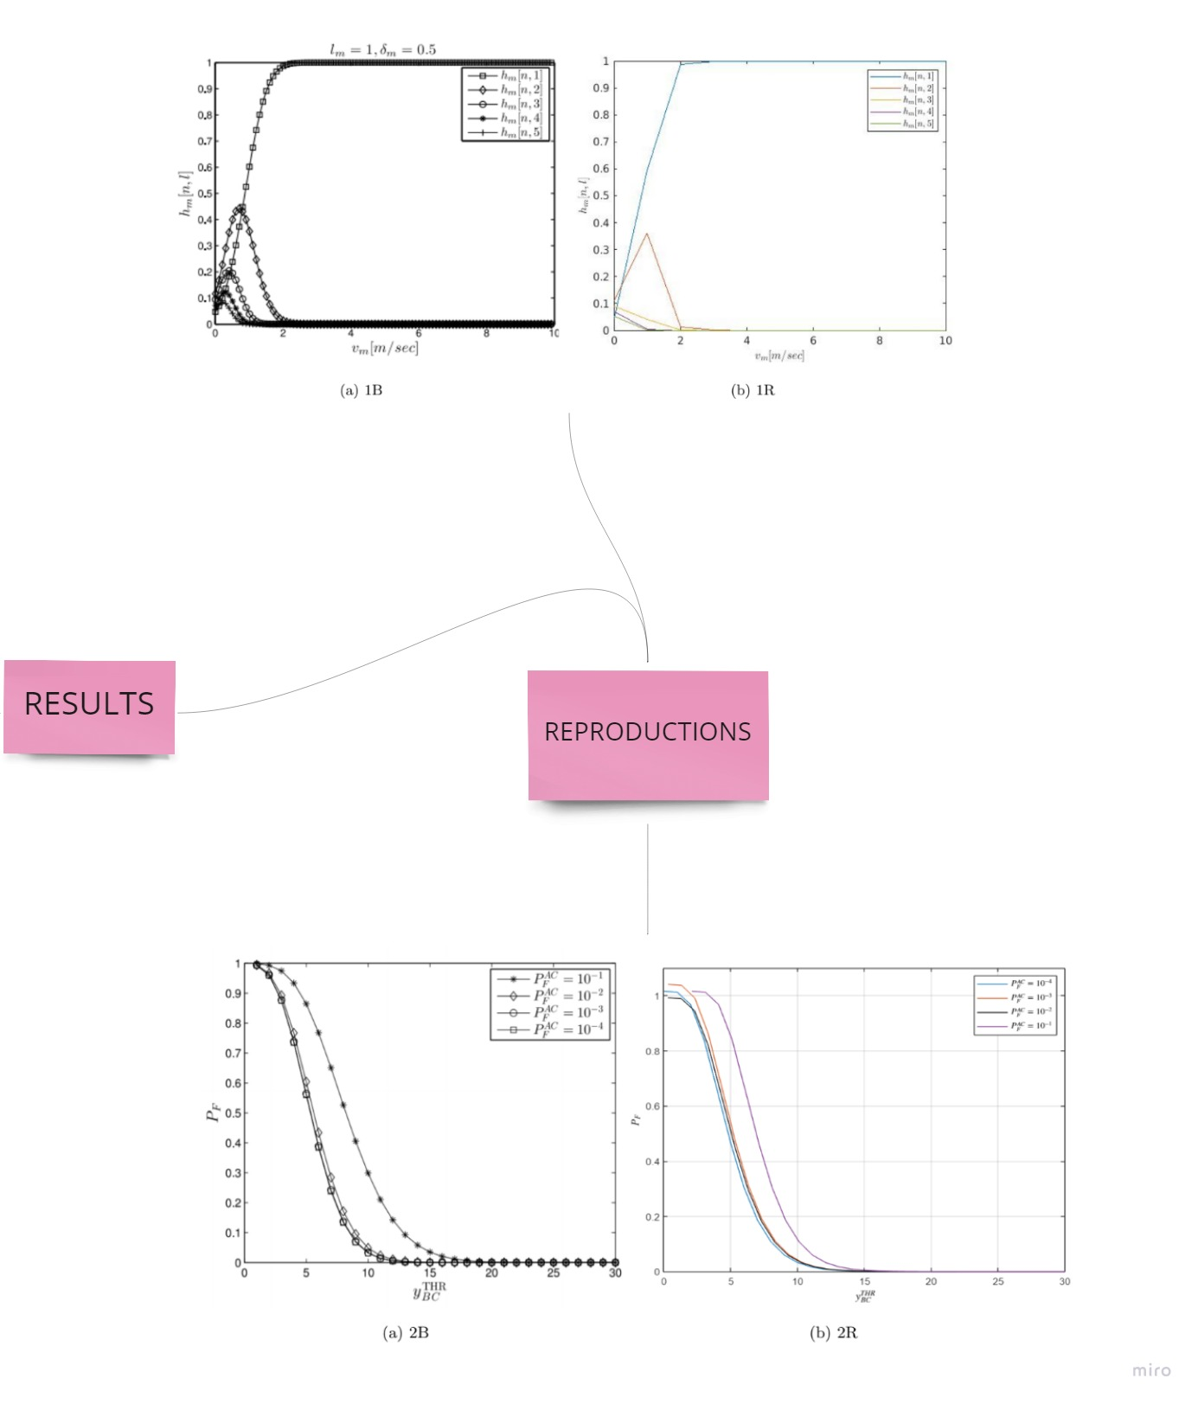
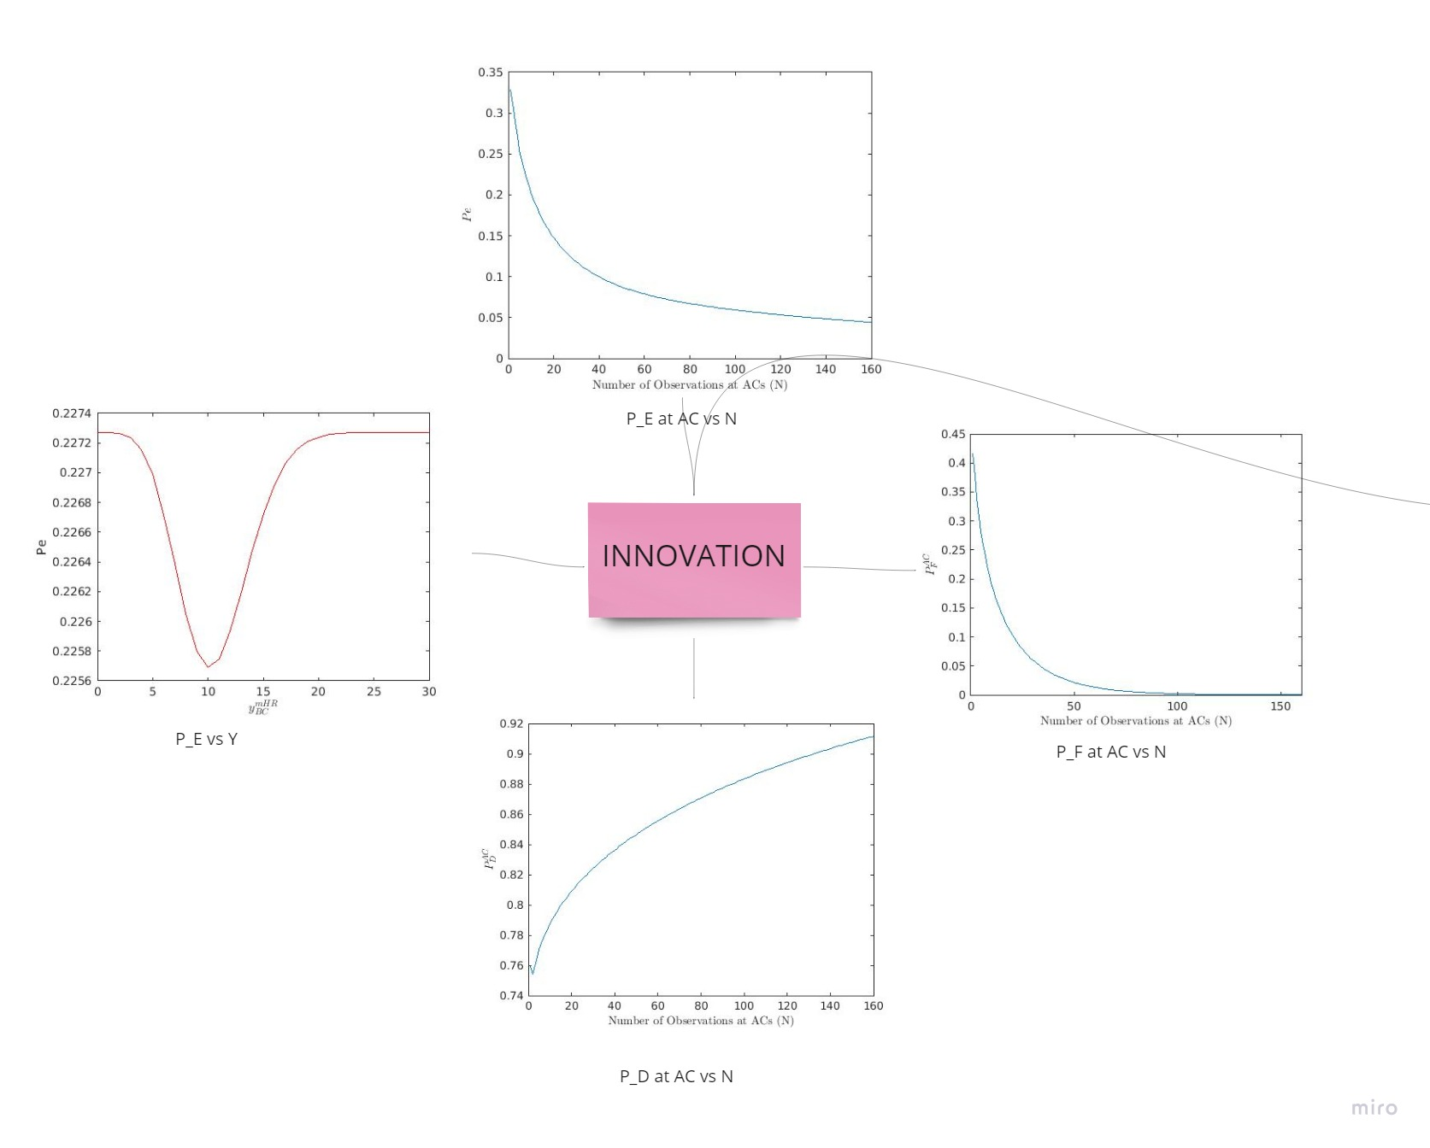
Results

Slide 12

Video

